Slide 2
Daniel 3:8-12

Slide 3
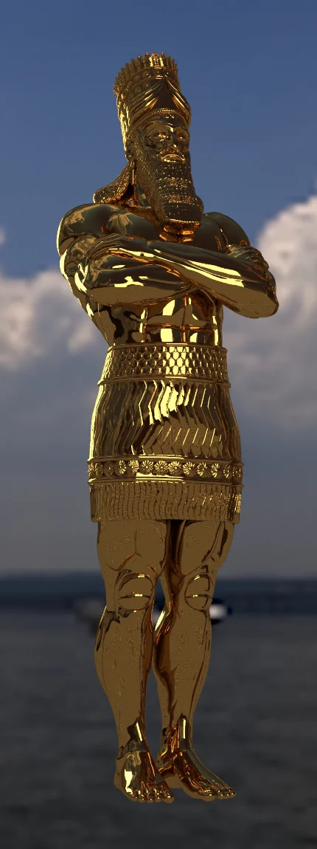
Nebuchadnezzar’s Golden Image
Daniel 3:1
Daniel 3:4,5
Daniel 3:6
Daniel 3:12
Daniel 3:13
Daniel 3:14,15
Daniel 3:16-18

Slide 4
How Much They Had To Overcome…
They Could Have Pled Authority
  “This is the command of our sovereign…”
  Mark 12:17 “Render to Caesar the things that are Caesar’s, and to God the things that are God’s.”
  Acts 4:18-20 “speak the things which we have seen and heard.”
  Exodus 1:15-17 “ did not do as the king of Egypt commanded them”

Slide 5
How Much They Had To Overcome…
They Could Plead Obligation
  King their friend & benefactor
  He had educated them, and advanced them to the most honorable positions
  Daniel 3:12 The principle of RIGHT must govern
  Matthew 10:34-38 “ I did not come to bring peace but a sword”
  “Should I leave my father’s religion?” Philippians 3:3-8; Galatians 1:13,14

Slide 6
How Much They Had To Overcome…
They Could Plead Universality of Compliance
  “Everyone else is doing it…”
  Exodus 23:2 “You shall not follow a crowd to do evil”
  1 Samuel 15:21 The people wanted to do it…
  Romans 12:2 “do not be conformed to this world”
  Titus 2:14 “His own special people”
  Ephesians 5:25-27 “holy and without blemish”
  “IF all yield, we will not, whatever the consequences”

Slide 7
How Much They Had To Overcome…
They Could Have Pled Dreadfulness of Penalty
  Often ready to justify our conduct on the basis of the pressure of the circumstances
  Sometimes situations make cowards of us!
  Often ready to yield to temptation if it will ease the pressure
  What have we ever suffered as compared with the suffering of the first century Christians, or the apostle Paul, or all the apostles save one, and multitudes of Christians?

Slide 8
God Kept Them From Harm
The God of Shadrach, Meshach and Abed-nego was glorified that day
  Daniel 3:28,29 “ there is no other God who can deliver like this.”
  Glorify God In Our Bodies Today!
  1 Corinthians 6:19,20 “ therefore glorify God in your body and in your spirit, which are God’s.”
  1 Peter 4:16 “16 Yet if anyone suffers as a Christian, let him not be ashamed, but let him glorify God in this matter.”

Slide 9
